Slide 1

Malmenator
Network Based Intelligent Malware Detection
David Han
Summer Analyst
Compliance Technology
Piyush Jha
Summer Analyst
Data Intelligence

Slide 2
The Status Quo: Malware Detection Today

Slide 3
Challenges: Drawbacks of the Status Quo
Slow
Limited Techniques
Database Reliance
Costly
Resource Consumption
Notes:
Traditional approaches towards analyzing malware involve
extraction of binary signatures from malware, constituting their
fingerprint.
Other approaches of analyzing malware include static code analysis
and dynamic code analysis. Static analysis works by disassembling
the code and exploring the control flow of the executable to look for
malicious patterns. On the other hand, dynamic analysis works by
executing the code in a virtual environment and a behavioral report
characterizing the executable is generated based on the execution
trace. Both these techniques have their pros and cons. Static
analysis offers the most complete coverage but it usually suffers
from code obfuscation. The executable has to be unpacked and
decrypted before analysis, and even then, the analysis can be
hindered by problems of intractable complexity. Dynamic analysis
is more efficient and does not need the executable to be unpacked or
decrypted. However, it is time intensive and resource consuming,
thus raising scalability issues. Moreover, some malicious behaviors
might be unobserved because the environment does not satisfy the
triggering conditions

Slide 4
Our Solution: Search Smart not Hard
Network Analysis
Predicting the likelihood of an attack
Understanding when an attack happened
Malware Detection
1
2
4
3
Handling the infected files
Understanding the type of malware
Malware Elimination
Malware Classification

Slide 5
Network Analysis
Predicting the likelihood of an attack
STEP 1
Network Packet Sniffing
Analyze Network Traffic
Identify Abnormality
Notes:
One can configure Snort in the following three different modes: a. Sniffer mode b. Packet logger mode c. Network intrusion detection mode In the sniffer mode of operation, Snort will read network packets and just display them on the console. In packet logger mode, it will be able to log the packets to the disk. In network intrusion detection mode, Snort will monitor the network traffic and analyse it based on the rules defined by the user. It will then be able to take a specific action based on the outcome. Please note that Snort has an inbuilt real-time alerting capability.
As expected, network IDS are placed at certain points within the network so that the traffic to and from all devices on the network can be monitored. Once an attack or an abnormal situation is identified, an alert can be triggered to the systems administrator to take corrective actions, as needed.

Slide 6
Malware Detection
Understanding when an attack happened
STEP 2
You can edit this text
1ou can edit this text
True/False Output
Identifies if the Node is at risk or not
OS Details
Ensemble
ML Model LightGBM
Disk Stats
17 Million Data Points
20 GB Data
81 Features
Dataset Source: Microsoft
Firewall Details
Processor Stats

Slide 7
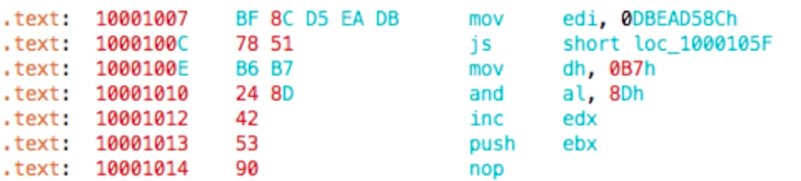
STEP 3
Malware Classification
Understanding the type of malware
You can edit this text
1ou can edit this text
Xgboost
Ensemble Learning
OP code Count
Multiclass Classification
9 Classes of Malware
Segment Count
20,000 samples
500 GB Data
Bytes + ASM
Dataset Source: Microsoft
ASM Pixel Intensity

Slide 8
STEP 4
Malware Elimination
Delete: Completely removes the file from the computer, which is useful if you don't want it anymore.
Clean: Removes the infection from the file but does not actually delete the file itself. This is the best option if you need to keep the file.
Quarantine: Moves the virus to a safe location that the antivirus software manages. This option does not delete or clean the file.
Dealing with the Malware

Slide 9
Business Impact
Current Losses
Reduction in Resource
Consumption
55 Billion USD
Every Year
For Corporates
Network Approach
vs
Node Approach
Highly Adaptable
Reduced Costs
Machine learning
vs
Rules Based
8 Billion USD
Spent Every Year
For Data Security
Notes:
Loss: https://www.webfx.com/blog/internet/cost-of-computer-viruses-infographic/

Slide 10
Our Vision
May 2020
March 2020
Malenator Dashboard Release
04
Malware Elimination Program Developed
Real-time Testing
03
02
January 2020
Malware Detection Model Release
Malware Classification Model Release
October 2019
01
Developed Network Analyzer

Slide 11


Malenator
Network Based Intelligent Malware Detection
David Han
Summer Analyst
Compliance Technology
HKU, Final Year
Piyush Jha
Summer Analyst
Data Intelligence
HKU, Final Year

